Slide 1
Employee Data Analysis using Excel
STUDENT NAME: JEEVIKA.K
REGISTER NO: 122202021
DEPARTMENT: B.COM (COPORATE SECRETARYSHIP)
COLLEGE: ANNA ADARSH COLLEGE FOR WOMEN

Slide 2
PROJECT TITLE
Employee Performance Analysis using Excel

Slide 3


AGENDA
Problem Statement
Project Overview
End Users
Our Solution and Proposition
Dataset Description
Modelling Approach
Results and Discussion
Conclusion
3/21/2024 Annual Review

Slide 4

PROBLEM STATEMENT To analyse and optimize the performance of the employees by evaluating the key metrics such as emp id , employees status , employee level , performance level etc .The analysis aim to identify the employees with greater efficiencies

Slide 5

PROJECT OVERVIEW The prime objective is to create an employee performance analysis using excel with the help of various functions such as conditional formatting , pivot table creation , chart etc..

Slide 6

WHO ARE THE END USERS 1. Employers 2. Employees 3. Organization

Slide 7

OUR SOLUTION AND ITS VALUE PROPOSITION
Filtering : To find the missing data
Chart : To get an graphical representation
Pivot table : To summarize the data
Conditional technique : Used to identify the missing data

Slide 8
Dataset Description
Employee dataset : Kaggle
Total : 26
Feature Used : 9 features
Employee id
First name
Last name
Business unit
Employee type
Gender
Performance score
Performance level

Slide 9

THE "WOW" IN OUR SOLUTION
Formula :
“=IFS(Z2>=5,"VERYHIGH",Z2>=4,"HIGH",Z2>=3,"MEDIUM","TRUE","LOW")”
This formula is used to find the performance level of the employees
which is derived as “medium , low and high” . And this performance level is used to get an graphical representation of the employees performance
CONDITIONAL FORMATTING :
This formula is used to find the performance level of the employees The conditional formatting is used to identify the missing data in a cell , highlight the missing cells and also to remove the missing cell
3/21/2024 Annual Review
9

Slide 10
MODELLING
DATA SCREENING : Downloaded an employee dataset from Kaggle , and saved the dataset in an folder then inserted the same in excel
DATA CLEANING : Using conditional formatting from home identified and removed the missing data and selected 9 datas from the data set like (emp id , name , gender etc)
DATA FORMULATING : Using “IFS” condition created an column of performance level using data from current employee rating which gave an output as medium , low , high
PIVOT TABLE CREATION : Select pivot table from insert and an pivot table is enabled , now select the required data. An pivot table is now created , We can also create pivot table through Queries and Connection icon
GRAPHICAL REPRESENTATION : After creating an pivot table select the pivot table and go to insert icon and select recommendation chart and an visual representation is created .
10

Slide 11
RESULTS
GenderCode | (All)
Count of Performance Score | Column Labels
Row Labels | High | Low | Medium | Very High | Grand Total
BPC | 37 | 80 | 152 | 34 | 303
CCDR | 45 | 89 | 141 | 25 | 300
EW | 41 | 78 | 160 | 23 | 302
MSC | 34 | 76 | 158 | 28 | 296
NEL | 50 | 73 | 158 | 23 | 304
PL | 50 | 68 | 151 | 32 | 301
PYZ | 44 | 85 | 146 | 24 | 299
SVG | 40 | 78 | 156 | 30 | 304
TNS | 38 | 75 | 160 | 24 | 297
WBL | 40 | 79 | 148 | 27 | 294
Grand Total | 419 | 781 | 1530 | 270 | 3000
11

Slide 12
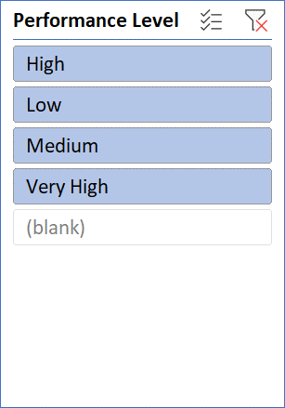

Slide 13
Conclusion The end output is created as employee performance analyses using various functions such as pivot table , graph etc . This helps to easily analyse the data . This performance analysis is used to find the employees with greater efficiency

